Slide 1

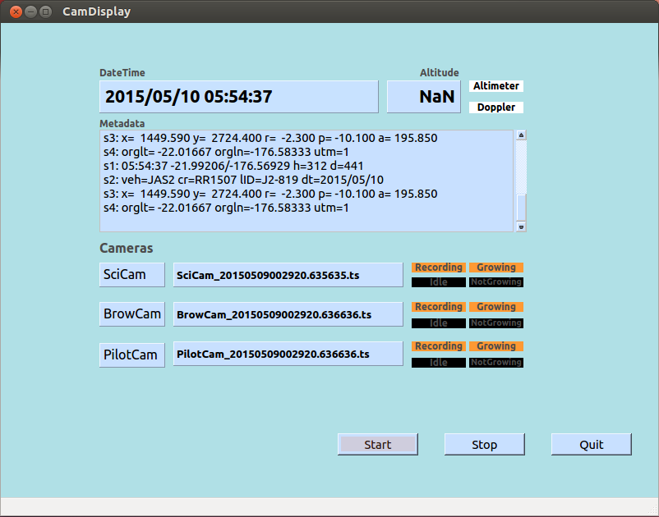
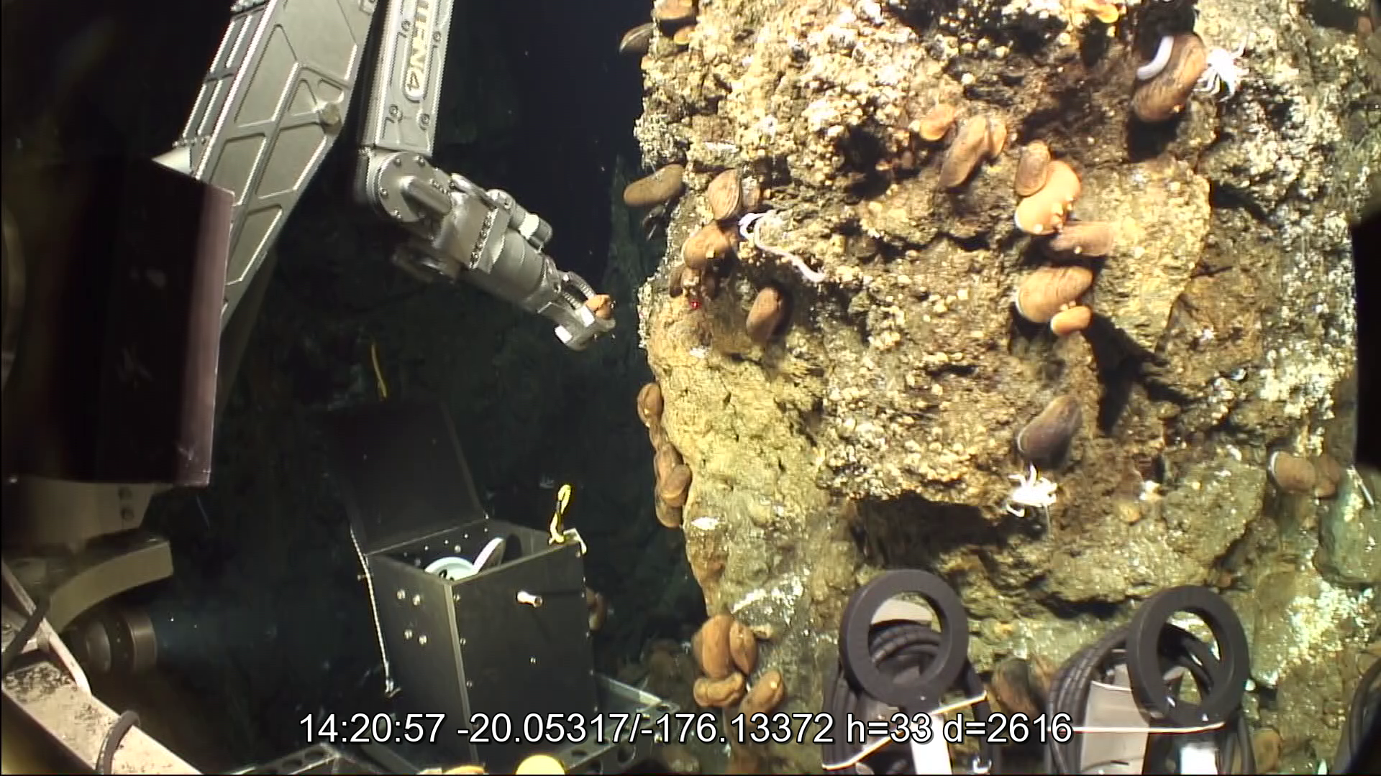
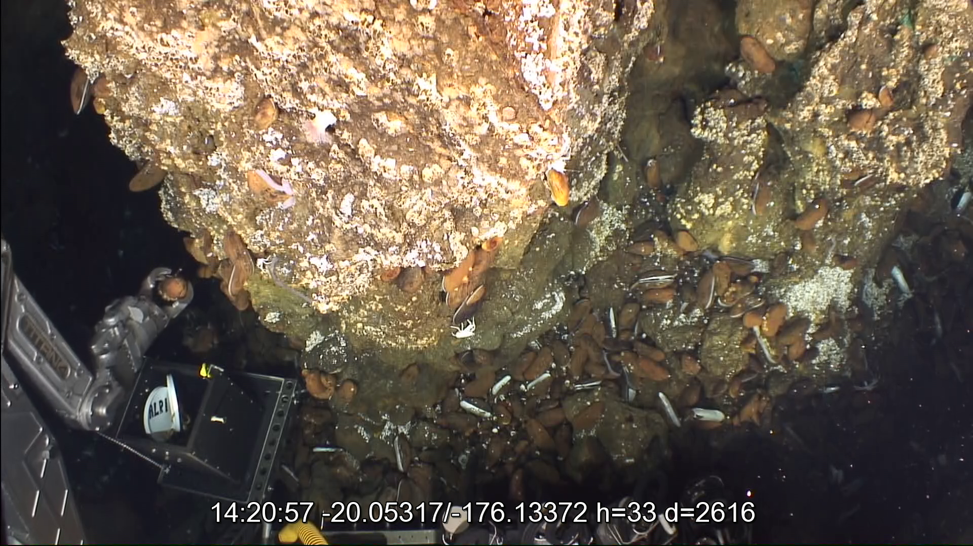
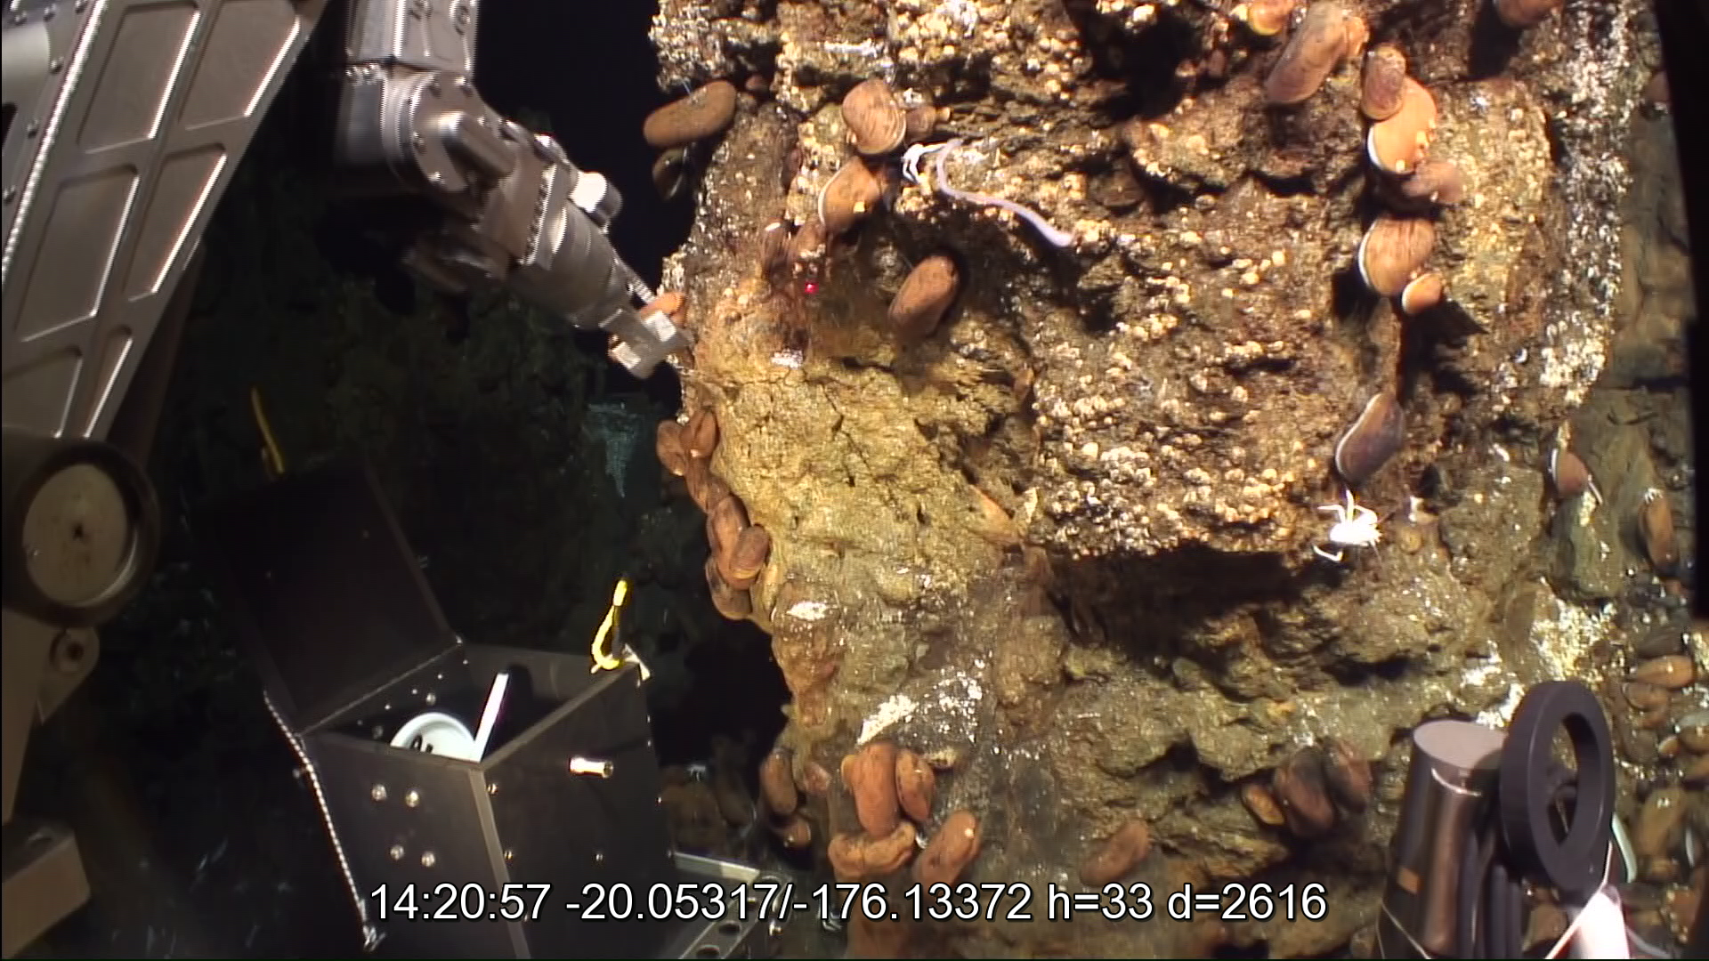
High Definition Video Recorder for Multiple Cameras on Long-Term Scientific Deployments
Scott J. McCue
Woods Hole Oceanographic Institution
National Deep Submergence Facility
smccue@whoi.edu,
Introduction
Results
Video is an information-dense form of data. For many of the researchers who use National Deep Submergence Facility vehicles, it is the preferred method of recording scientific activity. Video recordings are arguably the most popular form of electronic data delivered to operational clients of the deep submersible vehicles HOV Alvin and ROV Jason.
The melding of imaging and computing technologies has increased quality and convenience of recording while reducing cost. Challenges exist to balance the demand for high quality imagery against resource requirements for the capture, transfer, and long-term storage of this voluminous form of data. A custom-designed recorder has met these challenges for use in ROV Jason operations. This system can be adapted to use in a variety of applications.
The presented recorder successfully replaced DVD media recorders in 2014. Clients have received higher quality recordings (1920x1080 vs 640x480) in modern computer file format. Automated metadata collection has eliminated logging errors for constant-bottom recordings.
Jason additionally carries a “highlights” recorder (Aja KiPro) that applies an intermediate codec (ProRes422LT). Because of higher output volumes, use of this recorder is limited to select moments that might later be used for presentations or television.
We performed filesize comparisons for clips from the H.264 recorder and the ProRes422LT recorder:
Both recordings capture video at 1920 pixels x 1080 pixels resolution.
H.264 codec (6 Mbit/sec output), used by this recorder
2.67GB/hr/camera, 8.8TB/1100 hours/camera
Apple ProRes422 LT codec, “highlights” recorder.
53GB/hr, 175TB/1100 hours/camera
These filesize ratios permits substantial reduction in the resources required to deliver, transport, and archive hundreds of hours of video per cruise.
Also successfully implemented is a function that captures synchronized dive metadata and sensor measurements to text files. Four files, parameters grouped as described below, are written in standard subtitle format (.srt). These allow users to overlay annotations when compatible software (e.g., VLC) is used. Another file captured all of these parameters to a simple text file, with timestamps.
Subtitle file 1: UTC time, real time latitude, real time longitude, heading, depth.
Subtitle file 2: vehicle ID, cruise ID, lowering ID, date
Subtitle file 3: localX, localY, roll, pitch, altitude
Subtitle file 4: origin latitude, origin longitude, UTM zone
Feature Goals
Relevant Factors
A long-established practice of ROV Jason in field operations has been to record and archive imagery from Jason’s primary cameras (currently three) during all of the time that the vehicle is on the ocean bottom. Jason averages over 1100 hours annually on the bottom.
During Jason at-sea operations the handling of media and the logging of video metadata has historically been performed manually. This was error-prone and inefficient. An upgrade from hand-operated appliance-based recording to automated computer-based recording was a goal.
Routine industry practice is to apply a compression-decompression algorithm (codec) in real time to reduce bandwidth and volume. Codecs balance fidelity and post-capture usage against output data rate. Codecs called intermediates retain larger amounts of original information and products are typically used in frame-by-frame editing. Delivery codecs are meant for viewing and sharing, and little editing. Delivery codecs produce much less voluminous results. Since the constant on-bottom recordings from Jason are primarily intended to be viewed and not edited, it was appropriate to implement a delivery codec.
Future operational behavior will probably require control from outside the control van or from shore.
Criteria
We did not identify a commercial recorder that could satisfactorily address these targets. This led to the decision to build a system in-house that satisfies the following:
Capture of video from multiple, independent, high definition cameras.
Use of a codec that retains fidelity while using minimal storage space.
Automatic naming of files to source camera and time of capture.
Simultaneous capture of operational data and metadata (time, navigation, environmental data, dive ID, cruise ID) for annotation during video playback.
Automatically controllable on/off recording in reaction to vehicle behavior.
For Jason, auto start and stop in reaction to measurements of altitude above the ocean bottom.
Network connectivity for file transfer and remote operation.
Modular design to promote flexibility and upgradeability.
Figure 1: User interface to the recording system. Filenames are assembled in real time using camera name and system date-time. Status icons depict active recording. Filesystem checks have confirmed that clip files are growing. Metadata window displays lines written in real time to SRT-formatted subtitle files. Recorder operation was in manual mode, invoked by the start button. In altitude control mode the status icons depict which altitude measurement is in use for recorder start and stop.
Implementation
The codec that was selected is H.264, which offers the following:
Produces high quality imagery while using relatively little storage.
Is a widely used delivery codec.
Playback software is easily accessible to clients.
Popularity increases the lifetime of archived material.
Dedicated hardware is available, necessary for real-time compression.
The chosen encoder card (Hauppauge Colossus) is an internal computer card that captures 1080i video at full resolution (1920x1080 pixels). With the purchase of a commercial software driver (KernelLabs, Inc), the card is compatible with the linux operating system. Jason’s operational version of the recorder includes three encoder cards to record science, brow, and pilot cameras.
Linux has been selected as the operating system for the recorder because of its superior multitasking, networking, and development environments. The Ubuntu brand of linux has been chosen because it already is used in Jason operational operations.
Within linux the following development systems have been utilized:
The Python programming language.
The Qt application framework (pyqt), which provides threading, interprocess signaling, GUI, and networking support.
The gstreamer multimedia framework, which provides video stream-specific support.
To assure proper identification of camera signal, setup of the Ubuntu 12.04 device manager environment udev has been customized. This setup ties Colossus serial numbers, found in firmware, to standard linux device names (e.g., /dev/video0). These have in turn been linked by udev to custom device names, i.e., /dev/SciCam, /dev/BrowCam, and /dev/PilotCam. Proper stream identification persists as long as the usual Jason in-field practice that maintains cabling between camera and Colossus card remains in place.
Figure 2: Still grab from Jason’s primary science-use camera (SciCam). Annotation was overlain by video playback software using a subtitle file created in real time. Annotation shows the most popular overlay parameters: UTC time, latitude/longitude, heading, and depth. Video resolution is 1920x1080 pixels.
Figure 3: Still grabs from Jason’s two primary pilot-use cameras, BrowCam (left) and PilotCam (right). The grabbed moment is the same as SciCam in figure 2. Annotation was sourced from the same subtitle file.
Acknowledgments
The NDSF is sponsored by the National Science Foundation, the Office of Naval Research, and the National Oceanic and Atmospheric Administration. The operation is managed by WHOI and overseen by the University-National Oceanographic Laboratory System (UNOLS), an organization of 62 academic institutions and national laboratories involved in marine research.
The author extends appreciation to contributors to the open source software projects upon which this equipment was built:
GNU/Linux and Ubuntu
The Qt Project
Gstreamer
Python

